Slide 1
ARRAY IN JAVASCRIPT

Slide 2
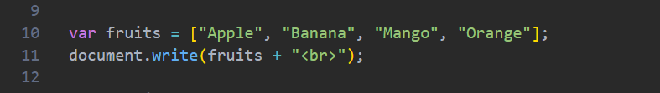

What is an Array?
An array is like a container that stores multiple related values in one place. It helps us organize, access, and manage data easily instead of creating separate variables for each value.
In this code, an array named fruits is created using the var keyword. The array stores three fruit names: Apple, Banana, Mango and Orange in a single variable. Each value inside the array is called an element, and elements are stored in any order we like.
Output we get:

Slide 3
Why do we use Arrays?
Arrays can store large amounts of related data efficiently. They reduce code repetition and make it easier to access, update, and manage data
This array stores multiple fruit names in one variable, making the data easier to handle.
Output we get:

Slide 4
Types of Arrays
1. Single-Dimensional Array (1D Array)
Thy are the simplest type of array that stores values in a single list or sequence. Example: List of names, Product list and Marks list.
2. Multidimensional Array (2D Array)
It is an array that contains one or more arrays inside it. It is used to store data in rows and columns. Example: Student marks table, Matrix.

Slide 5
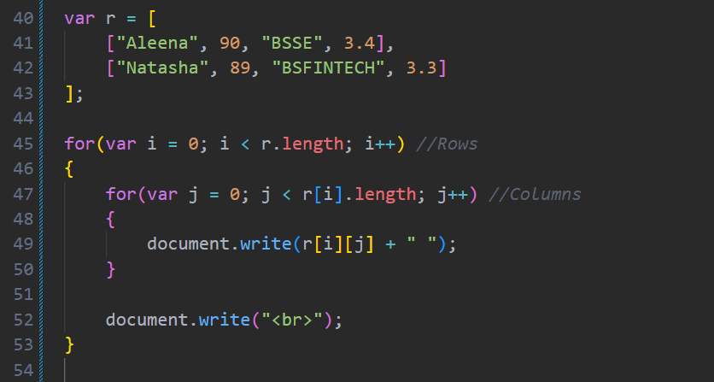

Output:

Slide 6
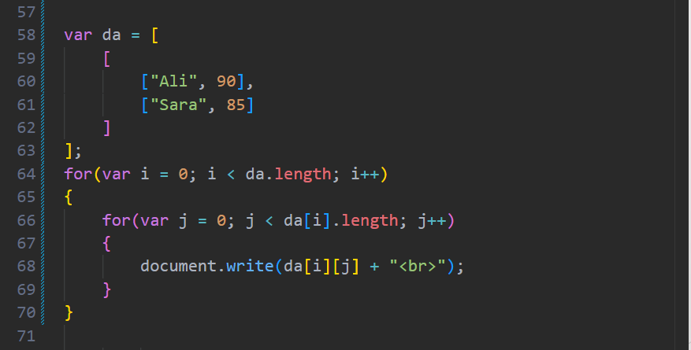
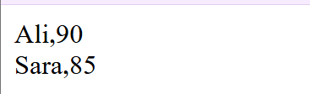
3. Three-Dimensional Array (3D Array)
It is an array contains arrays inside arrays inside another array. It is used to store complex data in multiple layers.. Example: 3D graphics, image processing, scientific data, and game development.
Output:

Slide 7
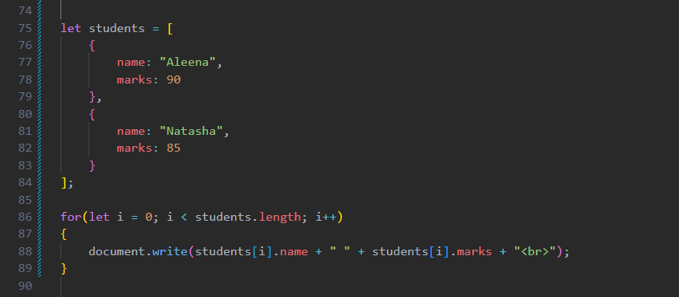
4. Array of Objects
An array of objects stores multiple objects inside a single array. Each object contains different properties and values. Example: student management systems, online shopping websites, employee records, and user databases.

Slide 8
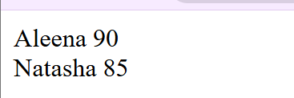
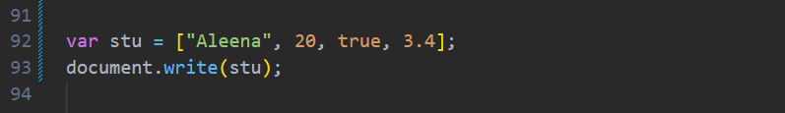

Output:
5. Heterogeneous Array
A heterogeneous array stores different types of data values, such as strings, numbers, and Boolean values, in a single array. Example: collection contains different types of information, such as user details containing a name, age, account status, and rating.
Output:

Slide 9
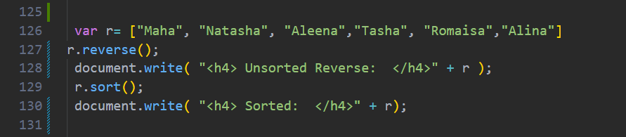
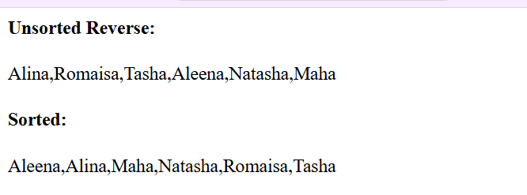
What are Array Methods?
Array methods are built-in functions in JavaScript that help us perform different operations on arrays easily, such as adding, removing, searching, sorting, and modifying data. For example, instead of writing long code to add or remove values, we can use built-in array methods like push(), pop(), sort() and find().
Output:

Slide 10
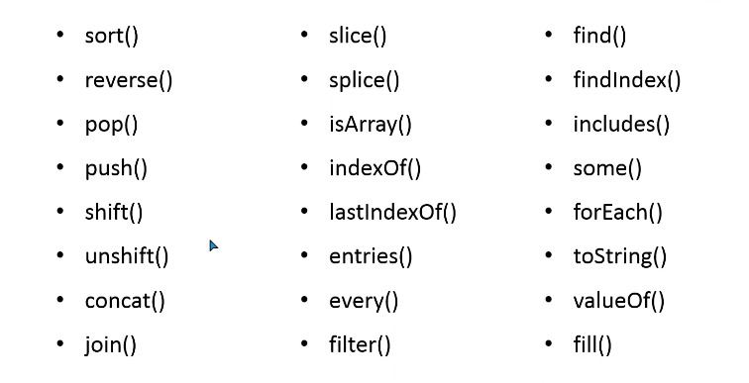
ARRAY METHODS

Slide 11
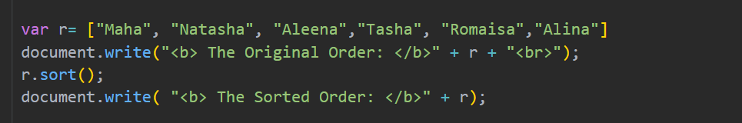

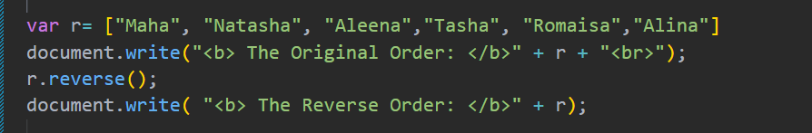

sort()
It arranges array elements in ascending alphabetical order.
2. reverse()
It changes the order of elements by reversing the array.

Slide 12
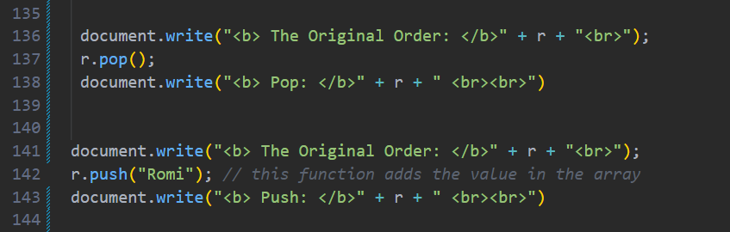
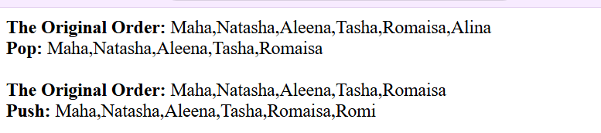
3. pop()
It removes the last element from an array.
4. push()
It adds a new element at the end of an array.

Slide 13
5. shift()
It removes the first element of an array.
6. unshift()
It adds the element at the start of an array.

Slide 14
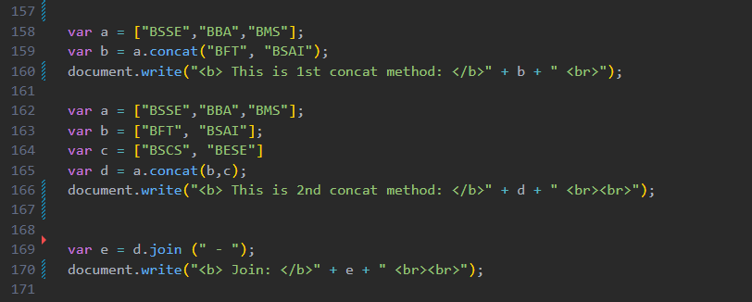
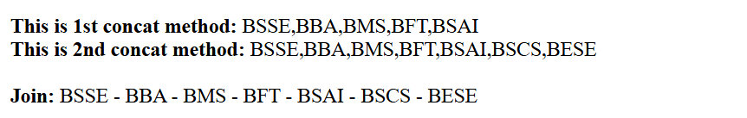
7. concat()
It combines two or more arrays into a new array.

Slide 15
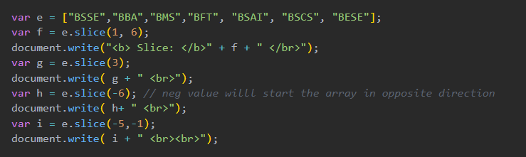
8. join()
It converts array elements into a string using a separator.
9. slice()
It extracts a part of an array without changing the original array.

Slide 16
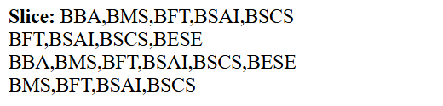
The slice() method is used to extract a part of an array and return it as a new array without changing the original array. It takes two values: the starting index and the ending index (ending index is not included). In this example, slice(1,6) returns values from index 1 to 5, slice(3) returns values from index 3 till the end, and negative values like slice(-6) or slice(-5,-1) start counting from the end of the array.
10. splice()
It adds, removes, or replaces elements in an array.
In this example, splice() can be used to add new values without deleting anything, remove a value and replace it with a new one, or simply delete values from a specific index.

Slide 17
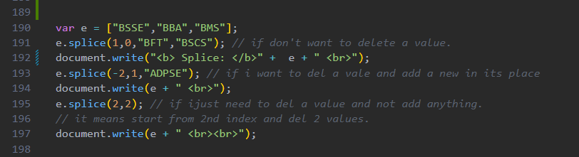
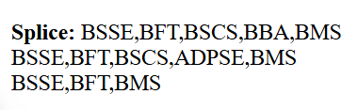
For example, e.splice(1,0,"BFT","BSCS") adds new values at index 1, e.splice(-2,1,"ADPSE") removes one value and adds a new value in its place, and e.splice(2,2) deletes two values starting from index 2.

Slide 18
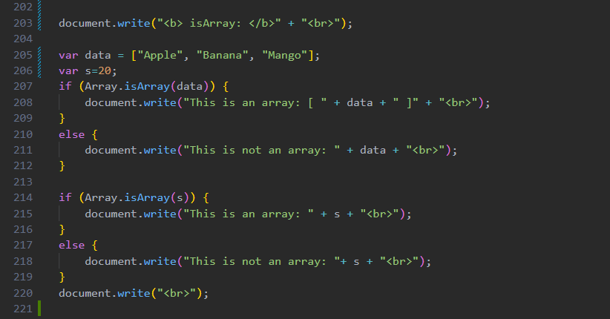
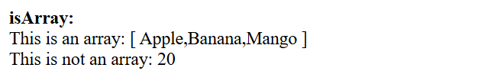
11. isArray()
It checks whether a value is an array or not.

Slide 19
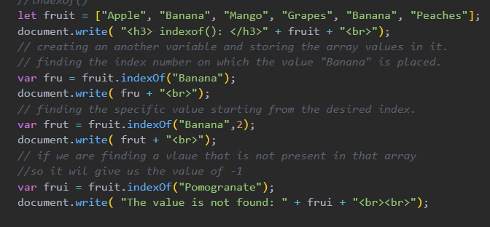
12. indexOf()
It returns the first index number of a specified value.

Slide 20
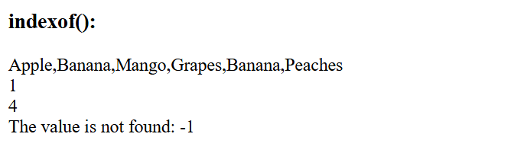
The indexOf() method finds the first occurrence of a specific value in an array and returns its index (position). If the value is not found, it returns -1. In this example, the first indexOf("Banana") returns 1 because "Banana" first appears at index 1. The second indexOf("Banana", 2) starts searching from index 2, so it finds the next "Banana" at index 4. When searching for "Pomegranate", the value is not in the array, so indexOf() returns -1.

Slide 21
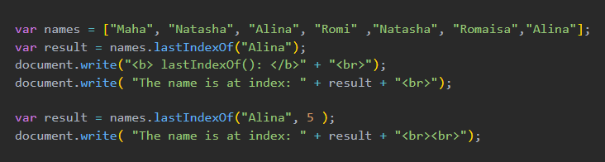
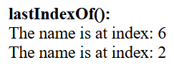
13. lastIndexOf()
It returns the last index number of a specified value.
The lastIndexOf() method finds the last occurrence of a specific value in an array and returns its index (position). If the value is not found, it returns -1. In this example, the first lastIndexOf("Alina") returns 6 because the last "Alina" is at index 6. The second lastIndexOf("Alina", 5) starts searching backwards from index 5, so it finds the earlier "Alina" at index 2 and returns 2

Slide 22
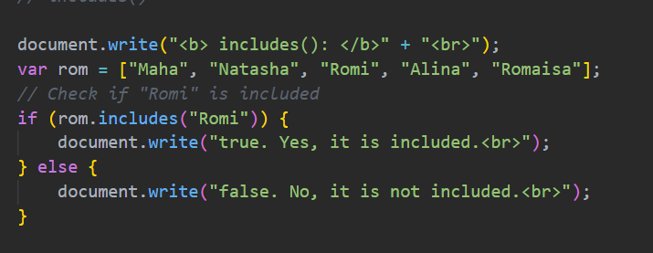

14. includes()
It checks whether a value exists in an array.
The includes() method checks whether a specific value exists in an array or not. If the value is found, it returns true. If the value is not found, it returns false. In this example, the array contains "Romi", so includes("Romi") returns true, and the message "Yes, it is included." is displayed.

Slide 23
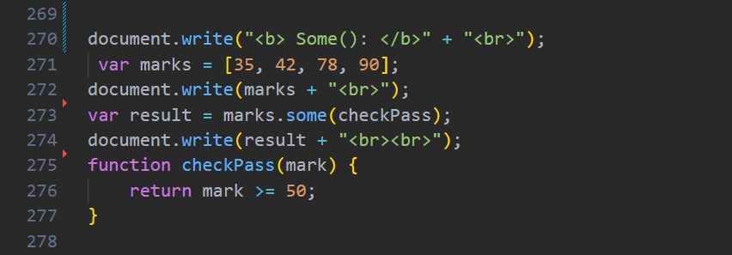
15. some()
It checks if at least one element passes a condition.
The some() method checks if at least one value in an array matches a condition. It looks at each element one by one, and as soon as it finds a matching value, it stops checking and returns true. If none of the values match the condition, it returns false. In this example, the condition is mark >= 50. Since 78 and 90 are greater than or equal to 50, the result is true.

Slide 24
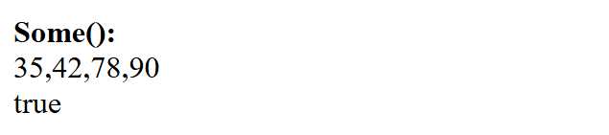
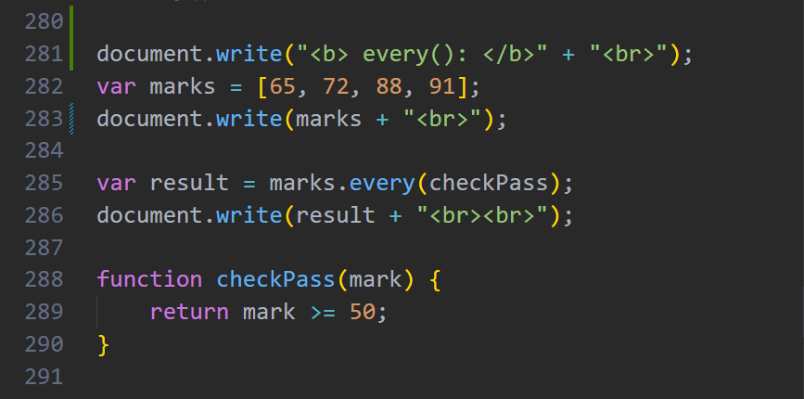
16. every()
It checks if all elements pass a condition.

Slide 25
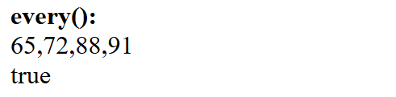
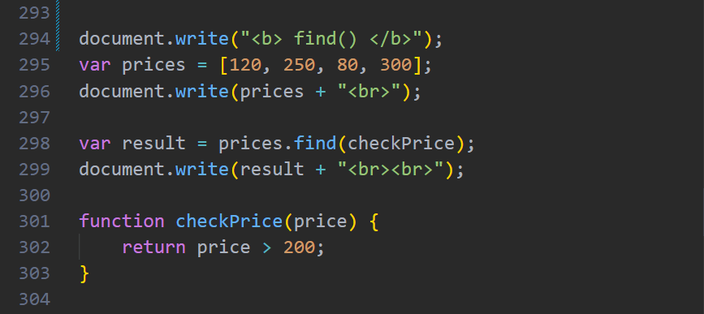
The every() method checks whether all elements in an array satisfy a given condition. If every value matches the condition, it returns true. If even one value does not match, it returns false. In this example, the condition is mark >= 50. Since 65, 72, 88, and 91 are all greater than or equal to 50, every() returns true.
17. find()
It returns the first element that matches a condition.

Slide 26
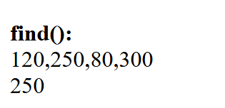
The find() method searches an array and returns the first value that matches a given condition. It checks each element one by one and stops as soon as it finds a matching value. If no value matches the condition, it returns undefined. In this example, the condition is price > 200. The array contains 250 and 300 but find() returns 250 because it is the first value that is greater than 200.

Slide 27
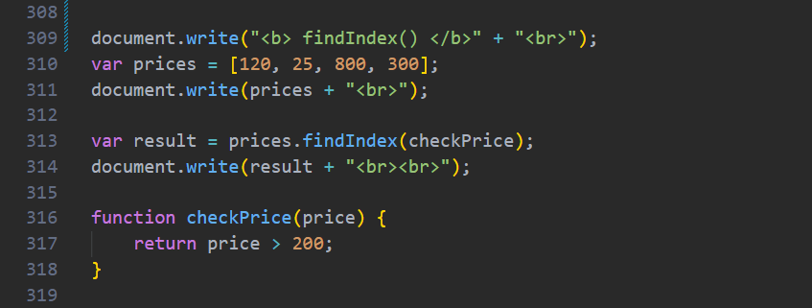
18. findIndex()
It returns the index of the first matching element.
The findIndex() method searches an array and returns the index (position) of the first value that matches a given condition. It checks each element one by one and stops as soon as it finds a matching value. If no value matches the condition, it returns -1. In this example, the condition is price > 200. The first value that satisfies this condition is 800, which is at index 2, so findIndex() returns 2.

Slide 28
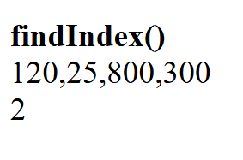
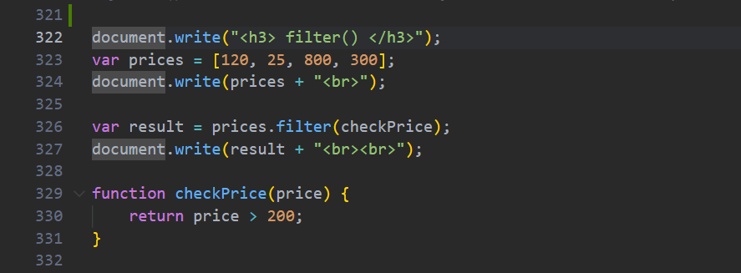
19. filter()
It creates a new array containing elements that satisfy a condition.

Slide 29
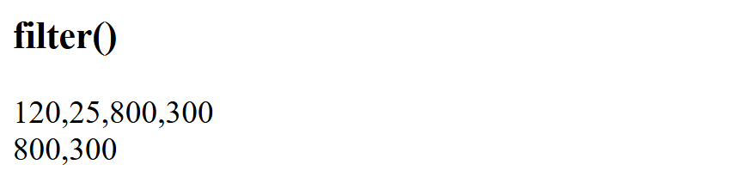
The filter() method creates a new array containing all the values that match a given condition. It checks every element in the array and keeps only the values that satisfy the condition. If no value matches, it returns an empty array. In this example, the condition is price > 200. Since 800 and 300 are greater than 200, filter() returns a new array containing 800 and 300.

Slide 30
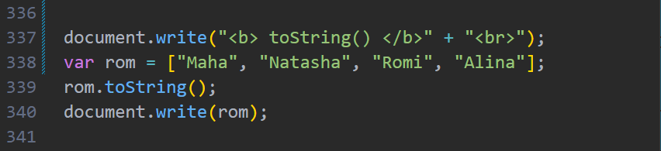
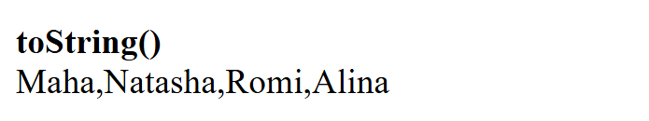
20. toString()
It converts an array into a string permanently..
The toString() method converts all the elements of an array into a single string. The values are joined together and separated by commas (,). It does not change the original array; it only returns the string version of it. In this example, the array ["Maha", "Natasha", "Romi", "Alina"] is converted into the string "Maha,Natasha,Romi,Alina", which is then displayed on the webpage.

Slide 31
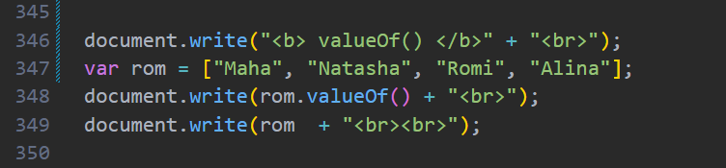
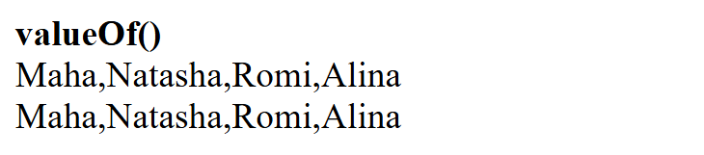
21. valueOf()
It returns the original array value.
The valueOf() method returns the original array itself. It does not create a new array or change the existing one. In most cases, valueOf() and simply writing the array give the same output. In this example, both rom.valueOf() and rom display Maha, Natasha, Romi, Alina, because valueOf() returns the original array.

Slide 32
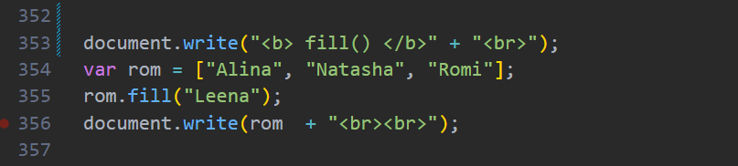
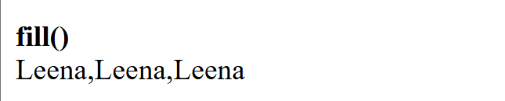
22. fill()
It replaces array elements with a specified value.
The fill() method replaces all or selected elements of an array with a new value. It changes the original array instead of creating a new one. In this example, rom.fill("Leena") replaces every name in the array with "Leena", so the output becomes Leena, Leena, Leena.

Slide 33
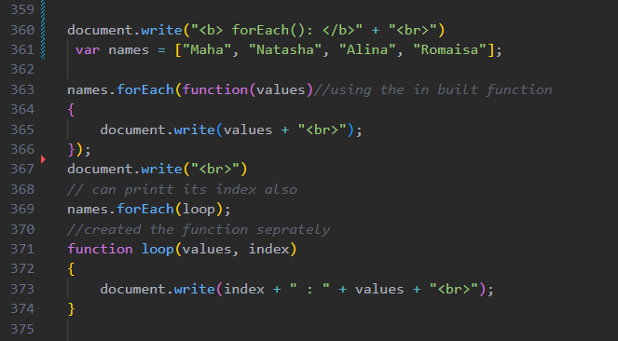
23. forEach()
It executes a function for every element of an array.

Slide 34
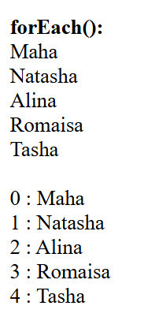
The forEach() method is used to go through each element of an array one by one and perform an action on it. It does not return a new array; it is mainly used to display, print, or work with each element. In this example, the first forEach() prints only the names, while the second forEach() uses a separate function to print both the index and the name. The output shows each name along with its position in the array.

Slide 35
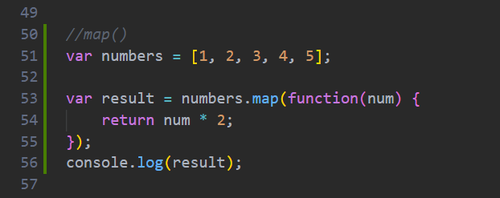
24. map()
The map() method goes through each element of an array one by one, performs an operation on each element, and returns a new array with the updated values. It does not change the original array.
The map() method visits each element in the numbers array one by one. Each number is passed to the function as num. The function multiplies the number by 2 and returns the result. After processing all the elements, map() creates a new array with the updated values. The original array remains unchanged.

Slide 36
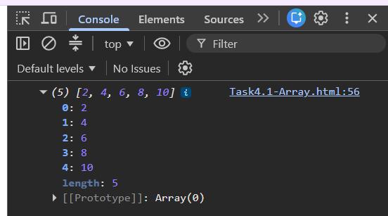
Why do we need Array Methods?
Array methods are used to easily work with arrays in JavaScript. They help us add, remove, search, sort, and modify data without writing long codes. They save time, make programs shorter, and make the code easier to understand. For example, instead of using a loop to print every array value, we can use the forEach() method. Array methods are useful when handling large data like student records, products, or user information.

Slide 37
Thank You

